Slide 1
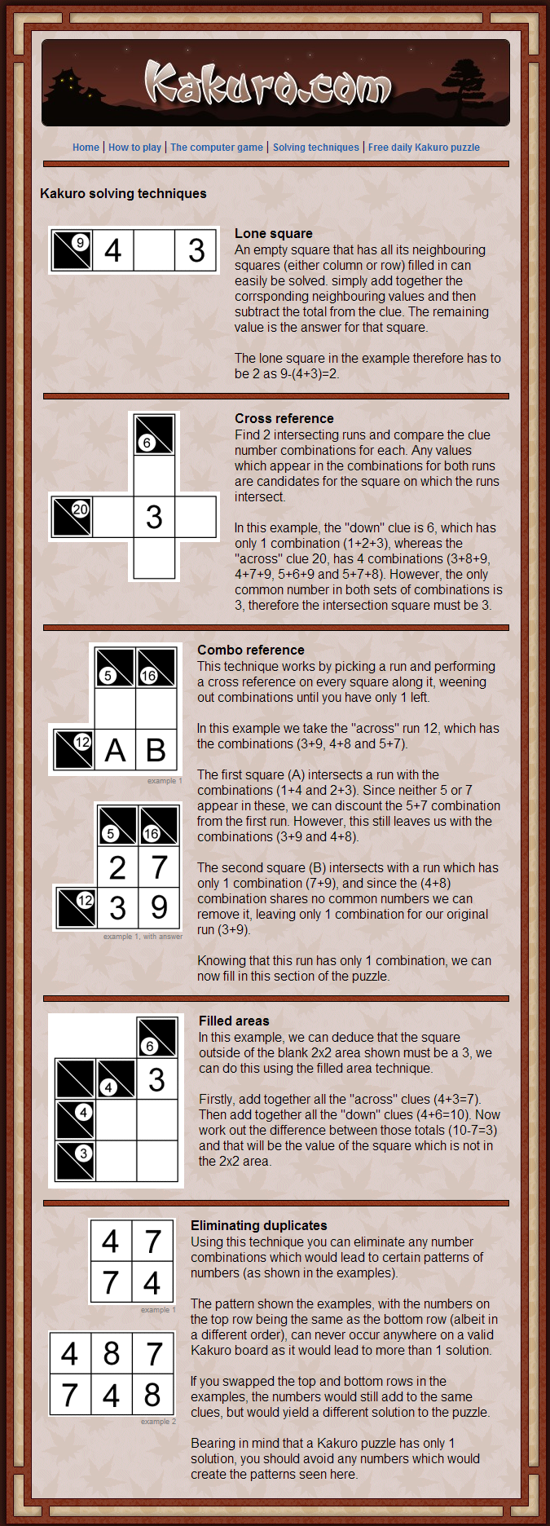
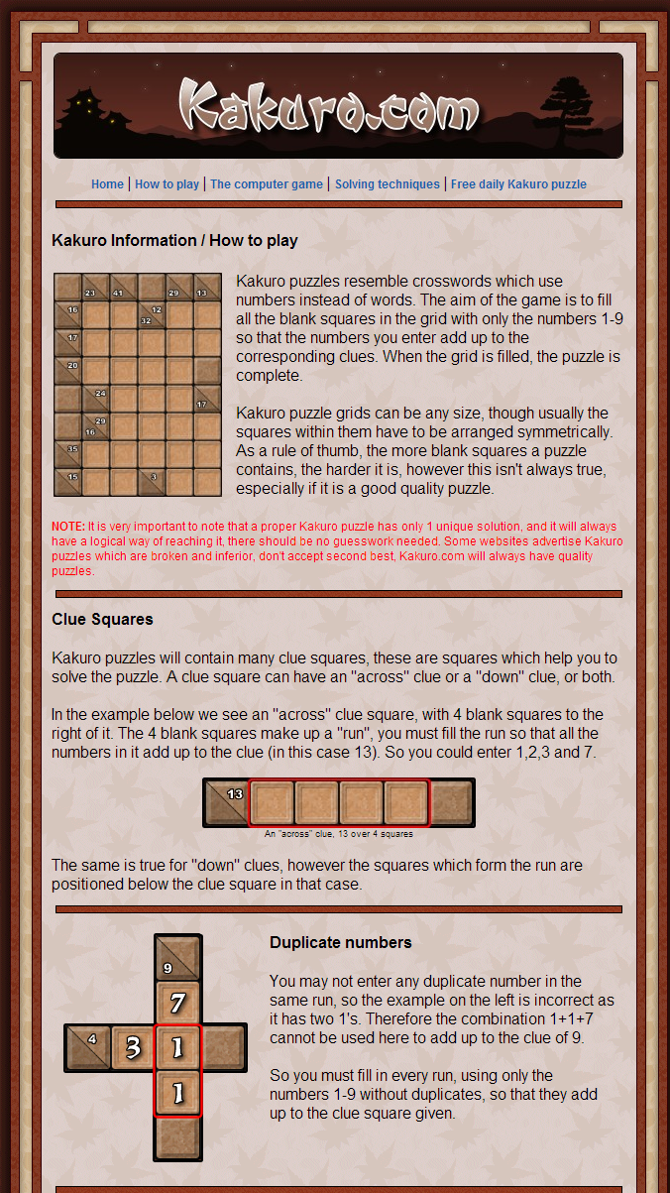
Data representation
Board and solver state
Rule representation
GUI
Solver
All-path
Learn to solve
Develop advanced rules like above

Slide 2
